Slide 1

Optimizing Renewable Power Generation in France

Slide 2
BY TEAM 1
Mohan Kumar Anem
Premal
Ankita Singh
Keerthana Velishala

Slide 3

Introduction
Dataset : Individual Household
Electric Power Consumption dataset.
Location: Near Paris, France.
Duration: December 2006 to November 2010 (47 months).
Data Frequency: Measurements taken for 4 years with one minute sampling rate.
Collected in Sceaux, France, this dataset serves as a crucial resource for optimizing renewable energy utilization and advancing sustainable energy practices.

Slide 4
Flow Chart
Goal Setup
Data Analysis
Data Pre Processing
Time series Model
Model Forecasting
Regression
Evaluation by Metrics
Optmizing by XG Boost
ML Models

Slide 5

Business Question
How can we analyze household's electricity consumption data over time to identify usage patterns, predict future energy needs, and recommend customized energy solutions that maximize efficiency and cost savings?

Slide 6
DataSet overview
Size of Dataset – 2M + ; Features – 9; Time – 2006/12 to 2010/11
date
time
global_active_power
global_reactive_power
voltage
global_intensity
sub_metering_1 (appliances like dishwasher, microwave oven)
sub_metering_2 (washing machine, tumble drier)
sub_metering_3 (electric water heater, air-conditioner)
TARGET VARIABLE- Apparent power
Apparent power= sqrt((reactive-power)^2+(active-power)^2)
It reveals the total current used by a combination of resistive, inductive, and capacitive components.

Slide 7

Data analysis
Data Preprocessing:
Process of Cleaning and Organizing the data.
Exploratory Data Analysis (EDA):
Statistical graphics and other data visualization techniques are used in the analysis of data sets.
Illustrating the distribution of important numerical variables (voltage, global active power, etc.).
Using graphs and bar plots to analyze the distribution of data.

Slide 8
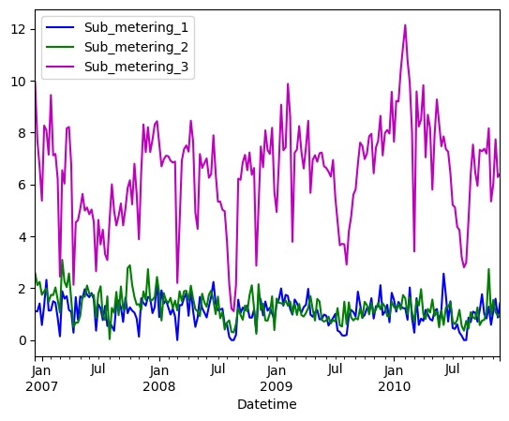
The weekly consumption patterns recorded by the three sub-meters.
Resampling to a weekly frequency and calculating the mean.
Highlights longer-term trends and patterns in the energy consumption data.
Electric water heater, air-conditioner are the highest power consuming devices.

Slide 9
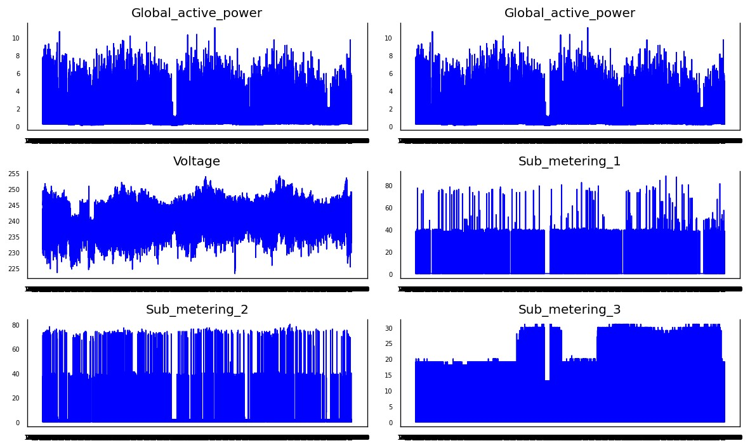
Patterns of each energy-related variable over time.
Understand usage patterns.
Identifying potential areas for energy savings.
Monitoring the performance of different electrical appliances.

Slide 10
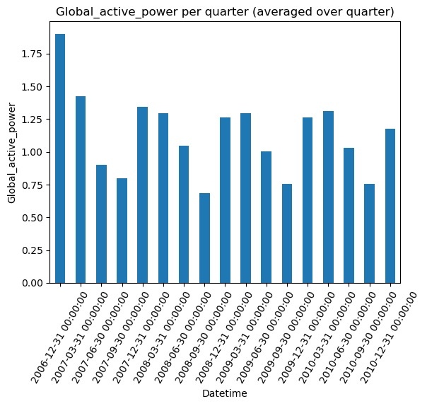
The average 'Global_active_power' consumption changes from one quarter to another.
Identifying seasonal patterns, trends, or anomalies in power usage.

Slide 11
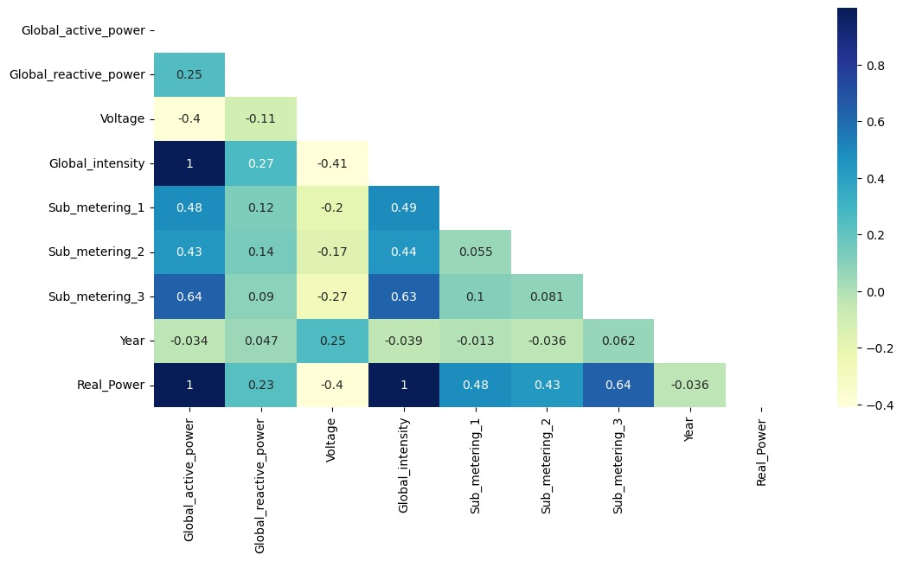
Correlation Matrix
Heatmap for exploring the relationships between variables in a dataset.
Sub_metering1,2,3 and Global_intensity are positively correlated with Real_Power.

Slide 12

Models
BayesianRidge, Ridge, and
LinearRegression have the same values.
RMSE: 0.5469204
Coefficient of Determination: 0.736874
R-squared: 0.7368732
Analysis: These three models have the
same RMSE and relatively high Coefficient
of Determination and R-squared values,
indicating a strong fit to the data.
These models are among the top
performers in terms of RMSE and R-squared.

Slide 13
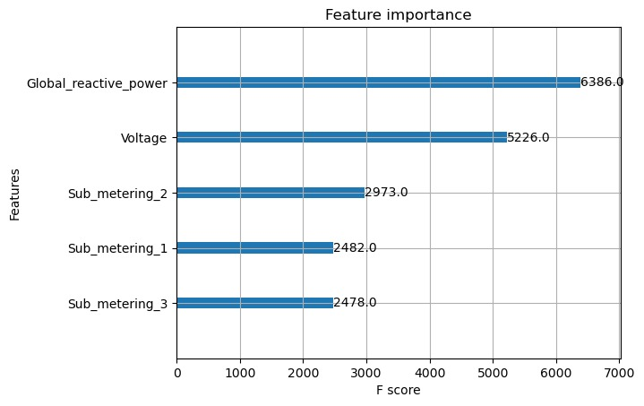
Feature Importance
The importance of each feature used
in the XGBoost model is plotted.
Shows features influence in
predicting the target variable.

Slide 14
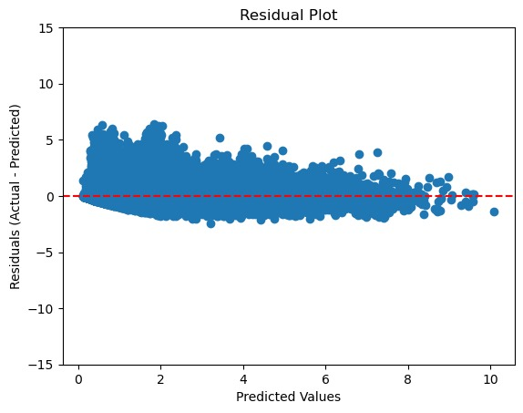
Residual plot
No model pattern(curve, clustering)
Constant variance.(homoscedasticity)
Potential Good Fit.

Slide 15

XGBoost
Mean Squared Error: 0.2619478644773082
Root Mean Squared Error: 0.5118084255630306
Optmizing the Model Performance.
Demonstrating data preparation.
Model training with parameter tuning.
Early stopping to prevent overfitting.

Slide 16
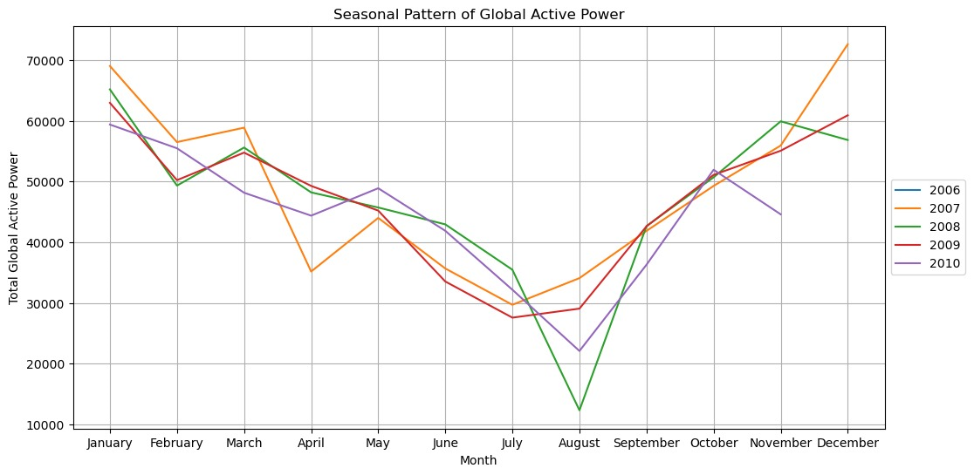
Seasonal Pattern
The graph shows that global active power is
lowest in the summer and highest in the
winter.
The graphs confirms there is seasonality,
trend and cyclic.

Slide 17
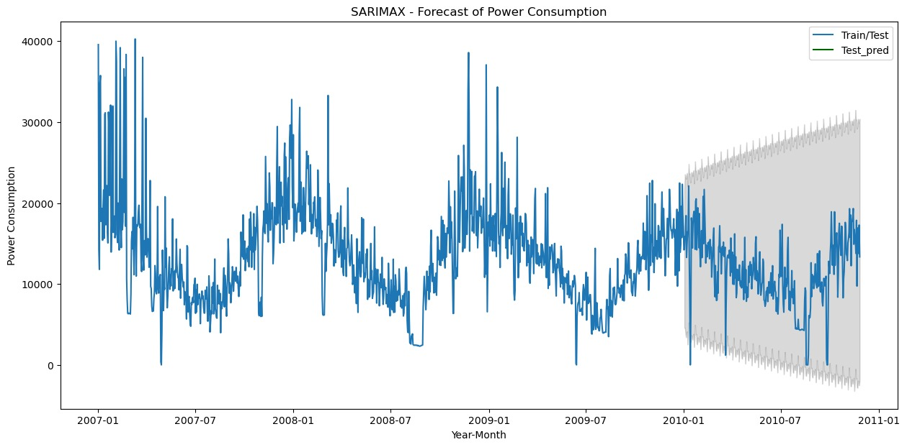
SARIMAX Forecasting
Forecasting power consumption using SARIMAX model.
Forecasting seasonal patterns.

Slide 18
Applications and Future Improvements
These forecasts are valuable for uncovering upcoming trends in electricity consumption.
Leveraging this analysis, power generation companies can estimate the required power generation for each specific region.
Employing this analysis on a regional scale yields enhanced insights for my PowerPoint presentation.

Slide 19
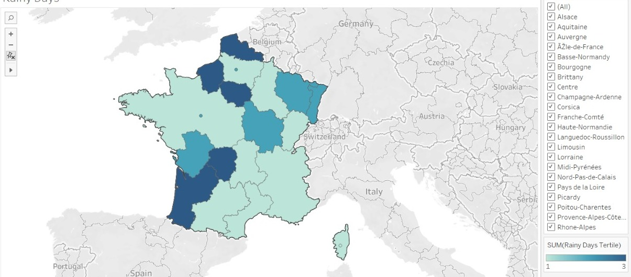
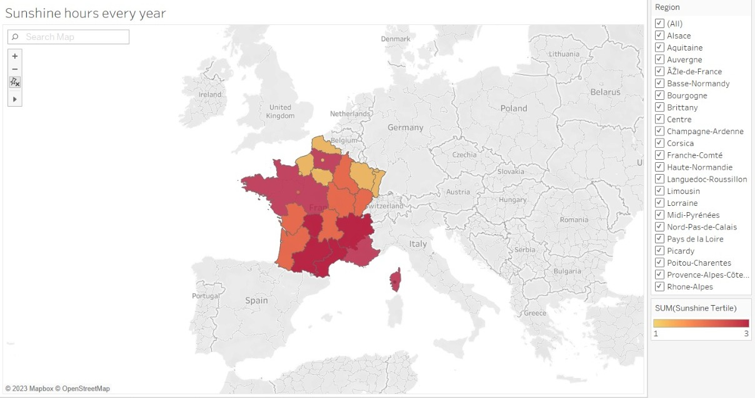
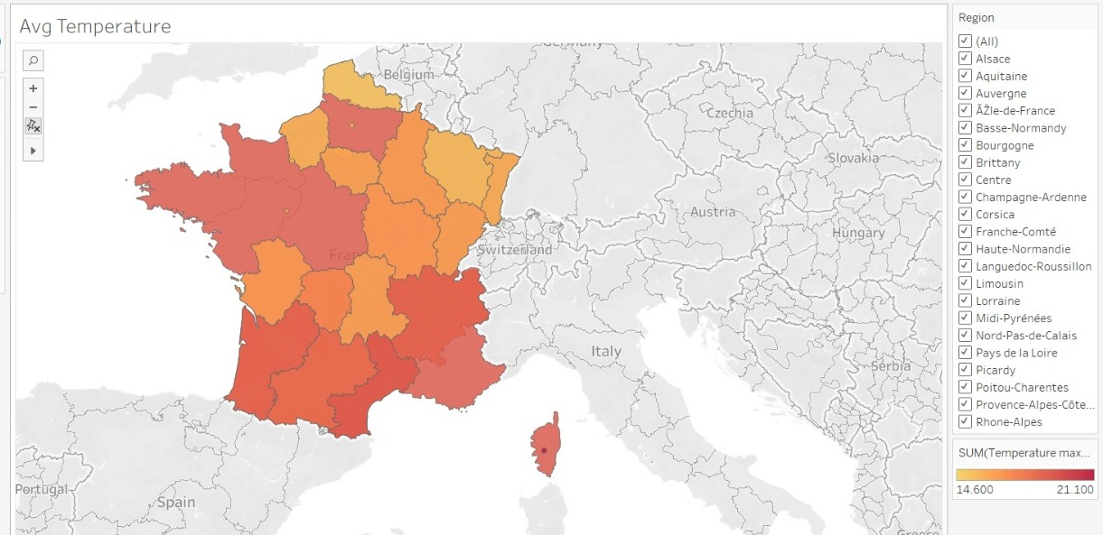
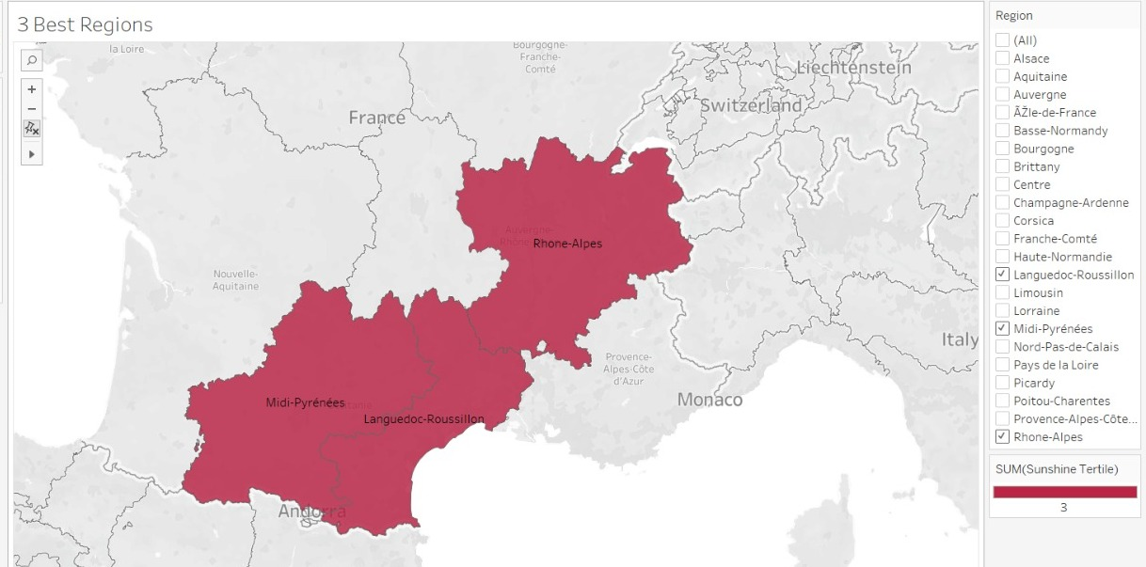
Geography and climate

Slide 20
Thank You

